Slide 1
ReShop&Rent- Team 16
D. Prajwal Reddy 1602-19-737-086
- B. Rahul 1602-19-737-087
- J. Pranavi 1602-19-737-184

Slide 2
Problem Statement
Problem Statement
-> Home-made Textile Waste management is still a hazardous problem that has been ignored and untackled since ages. India Produces 1 million ton of such household textile waste, ending up in landfills.
-> Most of this could be re-used by needy for various purposes, but are deprived of a platform to sell old clothes or to buy them.
-> ReShop&Rent is a sustainable, environment friendly web application addressing societal problems such as fast fashion, landfills etc.

Slide 3
Problem Statement
Solution
Main Objective:
The Main Objective of this Project is to bring platform to many people who own abundant quantity of minimal used redundant clothes. This also serves to people who are interested in buying clothes at cheaper prices or renting just for occasions or daily usage.
Specific Objectives:
Our Project Provides platform for everyone to re-sell or rent old clothes or for needy to buy at cheaper prices.
An Individual User can easily act as a seller and can be directly accessed by customers for products he/she has.

Slide 4
Problem Statement
Motivation for Extensions
-> ReShop&Rent is also a sustainable, environment friendly application addressing societal problems such as fast fashion, landfills etc
-> At the time of purchase, it is always a dilemma to check if the size is apt for you or not
-> The projects aspire to inculcate Machine Learning Algorithms.
->Machine Algorithm have been planed to deployed
Supervised – These apply what’s been learned in the past to new data using specific labeled examples. They can predict future events and compare their output to the intended results. That helps the algorithms improve themselves with ‘practice’.
Implementation – The Appropriate Size of the outfit selected will be recommended based on weigh, height and age of the users as it is not expected to keep track of body measurements like waist length, chest length etc.
Using Decision Tree Techniques for determing S, M, L, XL etc

Slide 5
Problem Statement
Tech Stack
Frontend :
HTML
CSS
JavaScript
Backend :
PYTHON
SQLLITE3 DB
Framework :
Flask

Slide 6
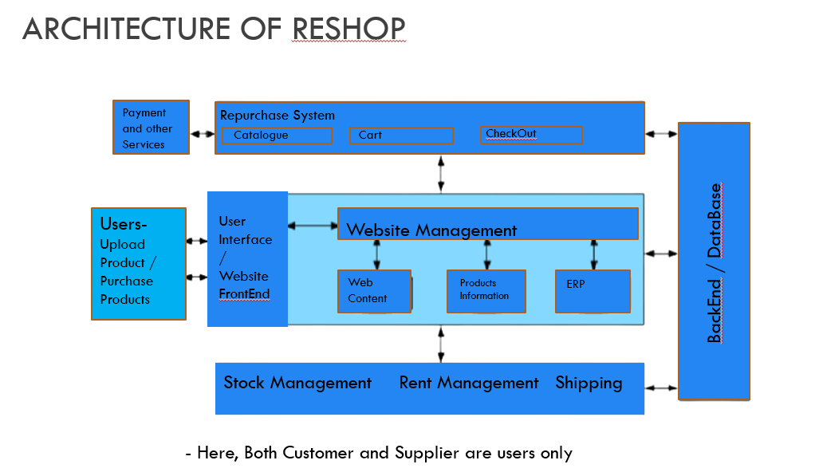
Problem Statement
ARCHITECTURE

Slide 7
Implemented NEW USE CASES
Search Product by Key word
Cancel a Product
My Sales
Search Customer Details By Name
View Other Products by this seller
Status of a Product
Renting products
Size prediction

Slide 8
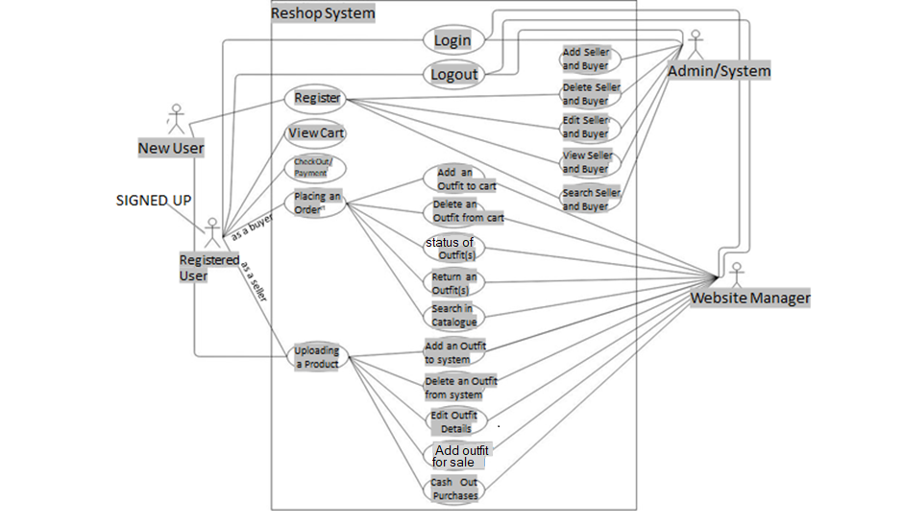
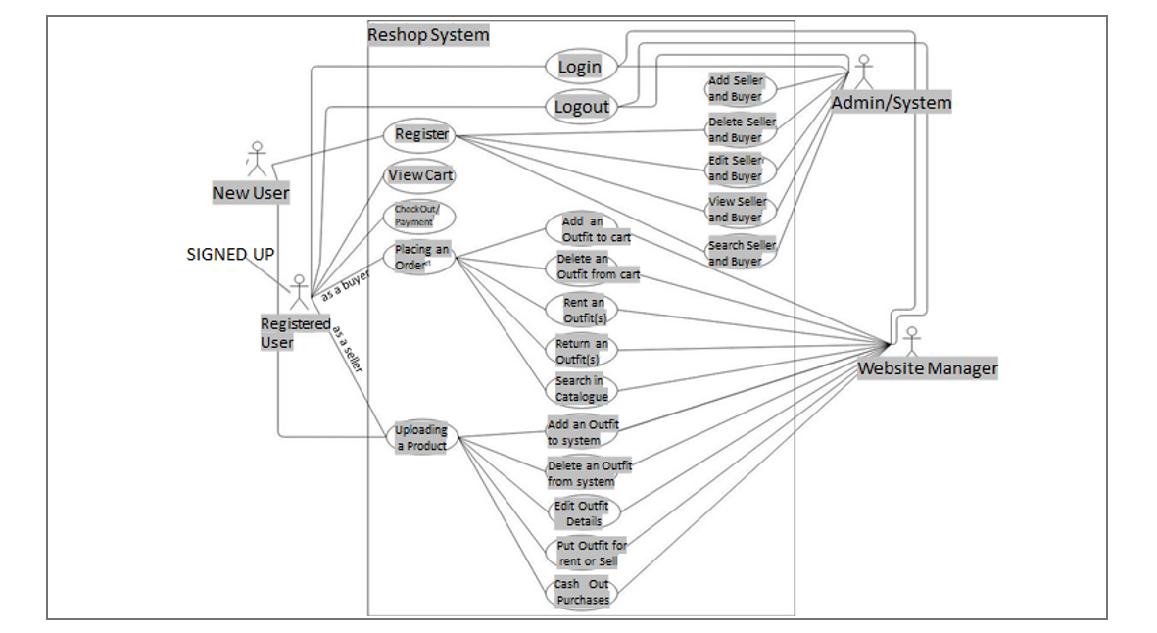
Problem Statement
Original
Use Case Diagram

Slide 9
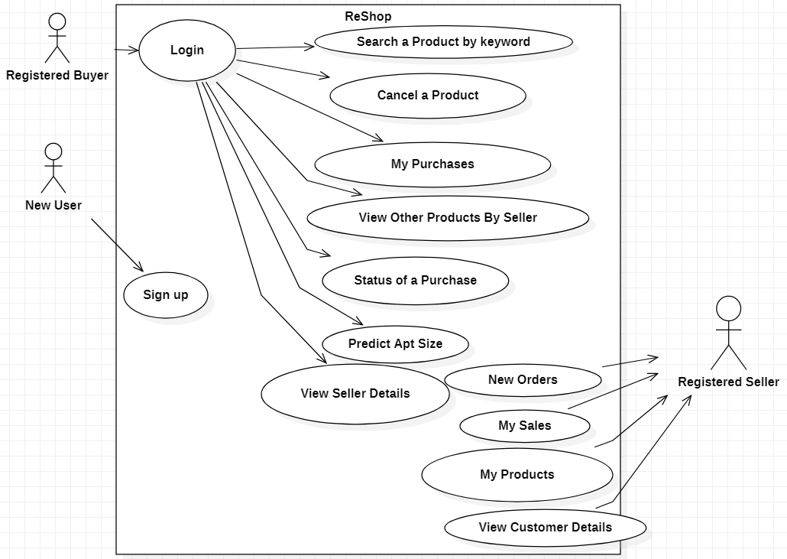
New USE CASE DIAGRAM

Slide 10
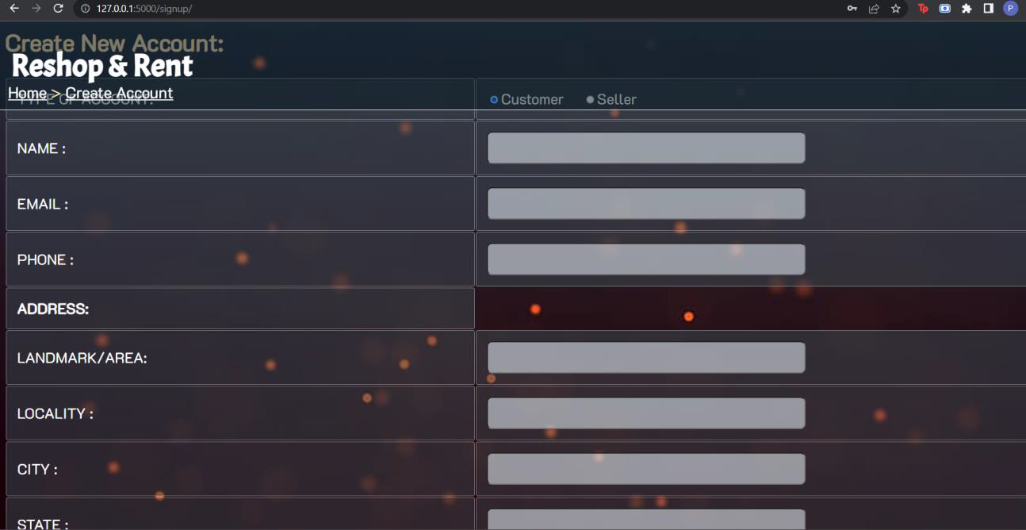
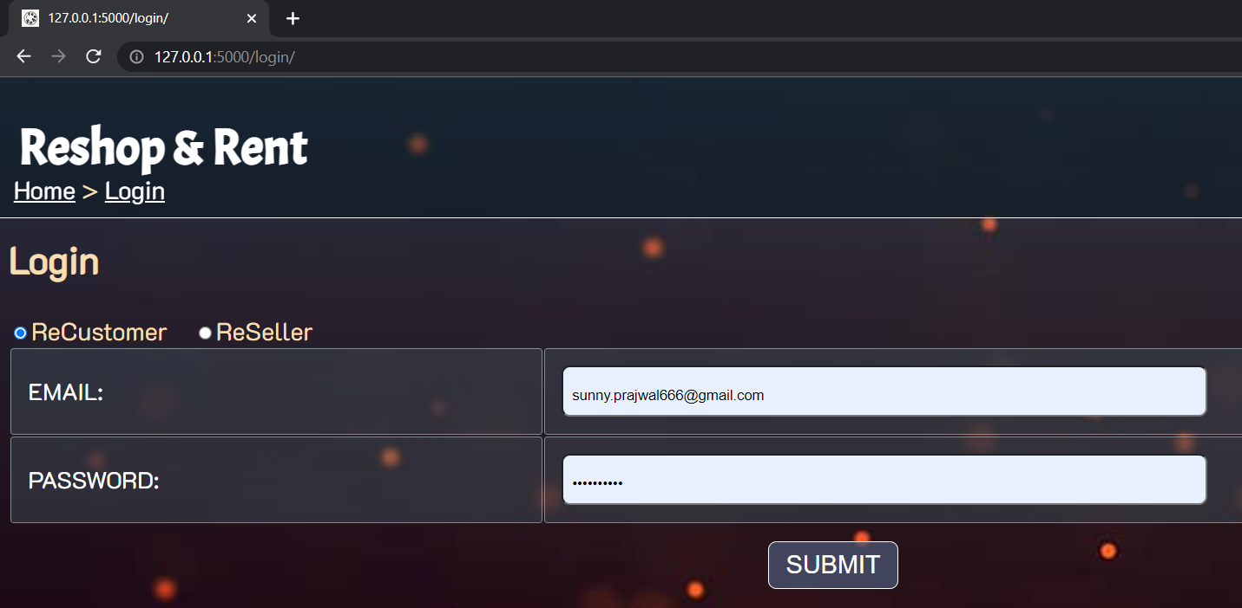
OUTPUTS

Slide 11
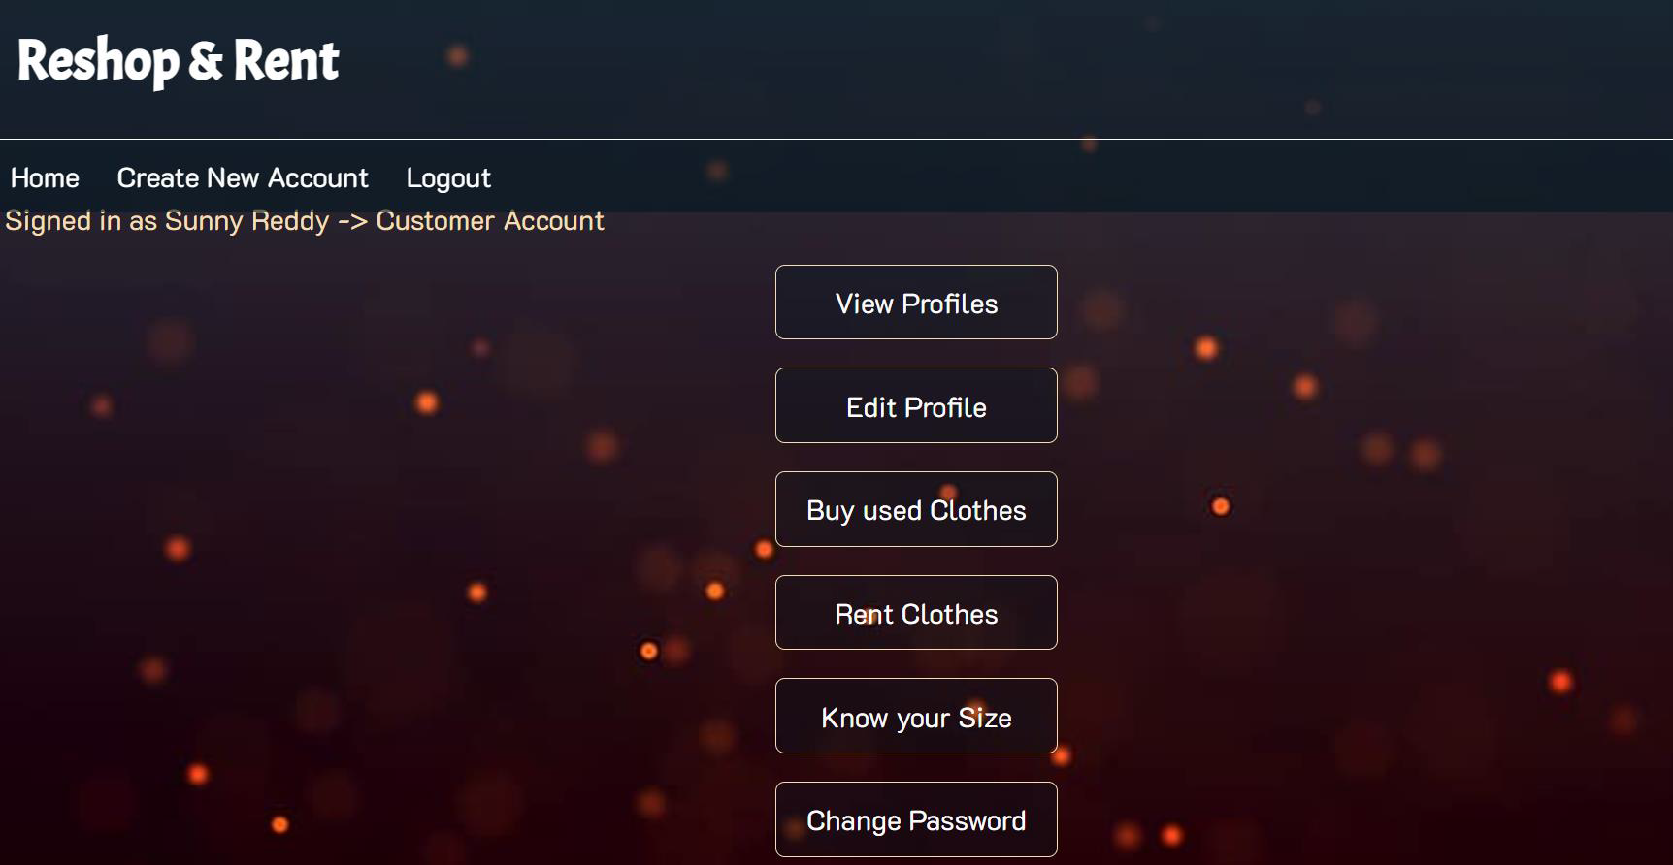
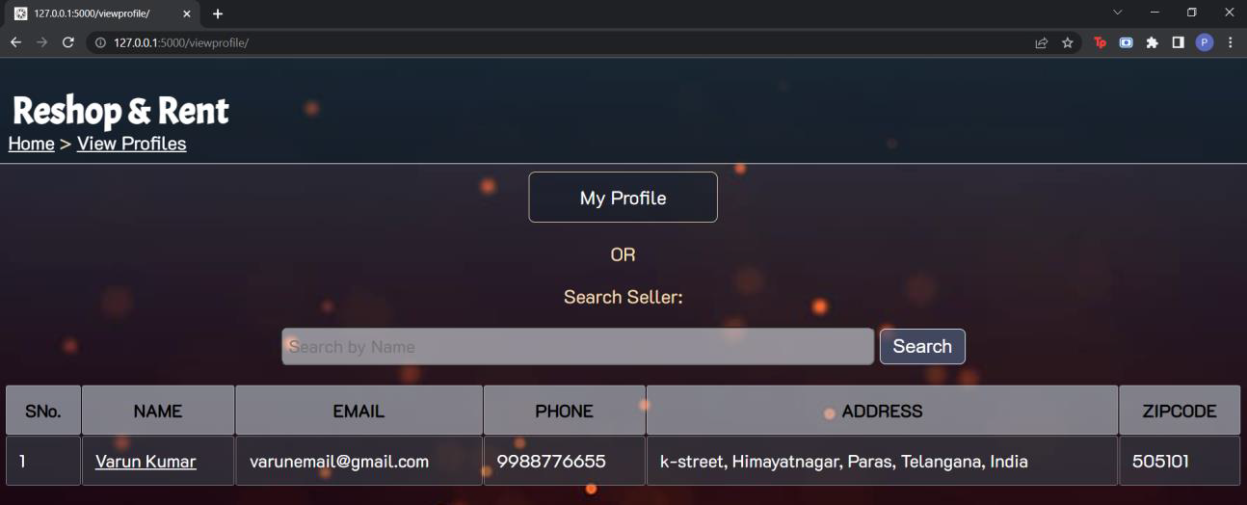
OUTPUTS

Slide 12
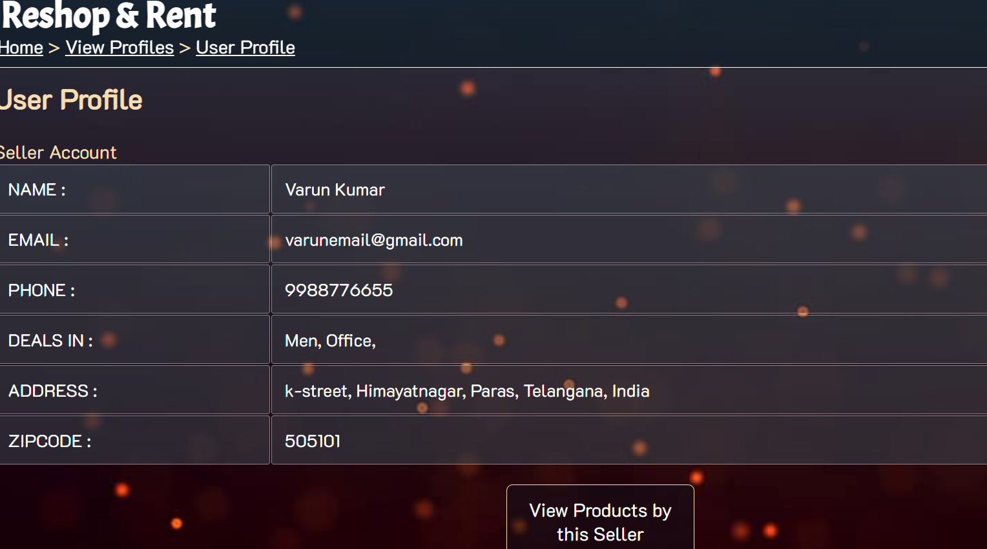
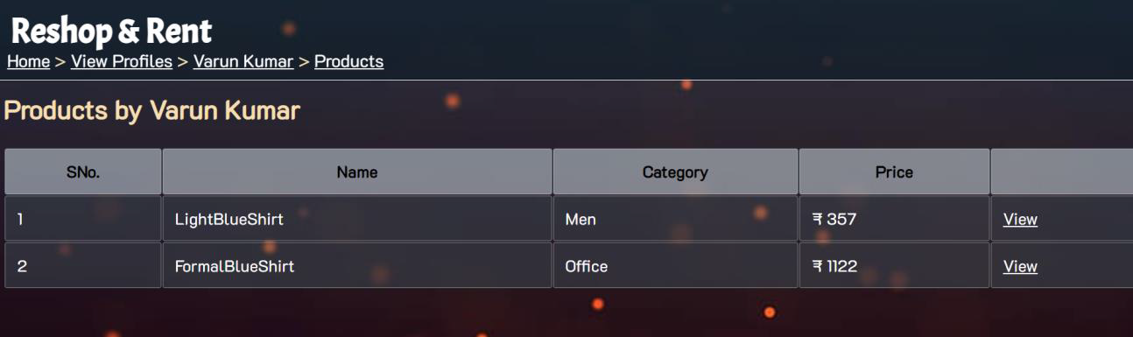
OUTPUTS

Slide 13
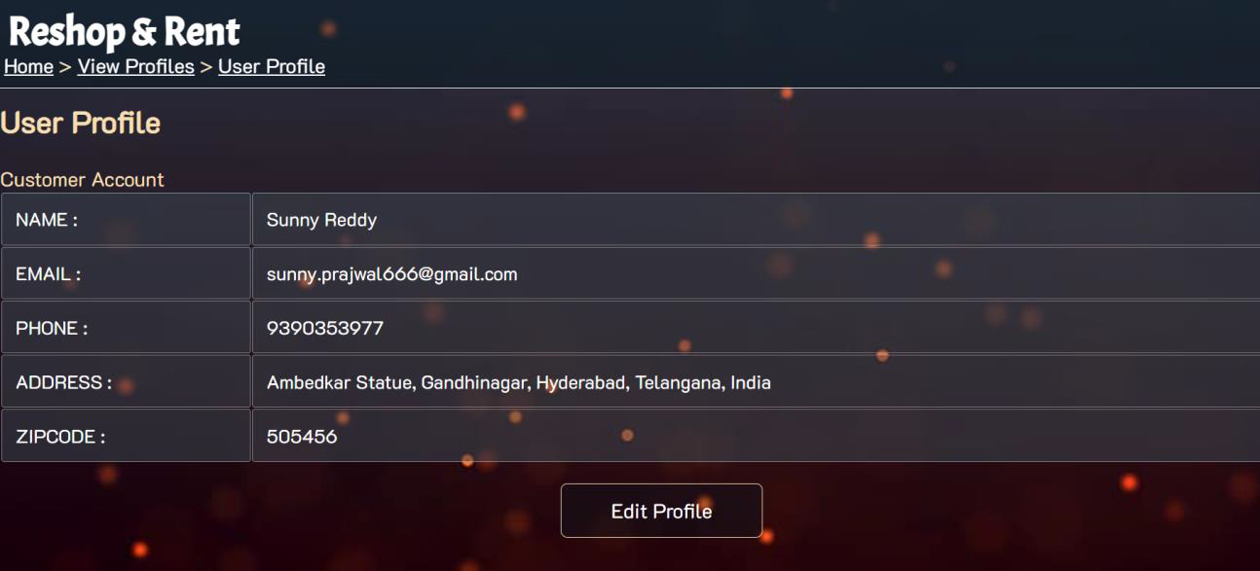
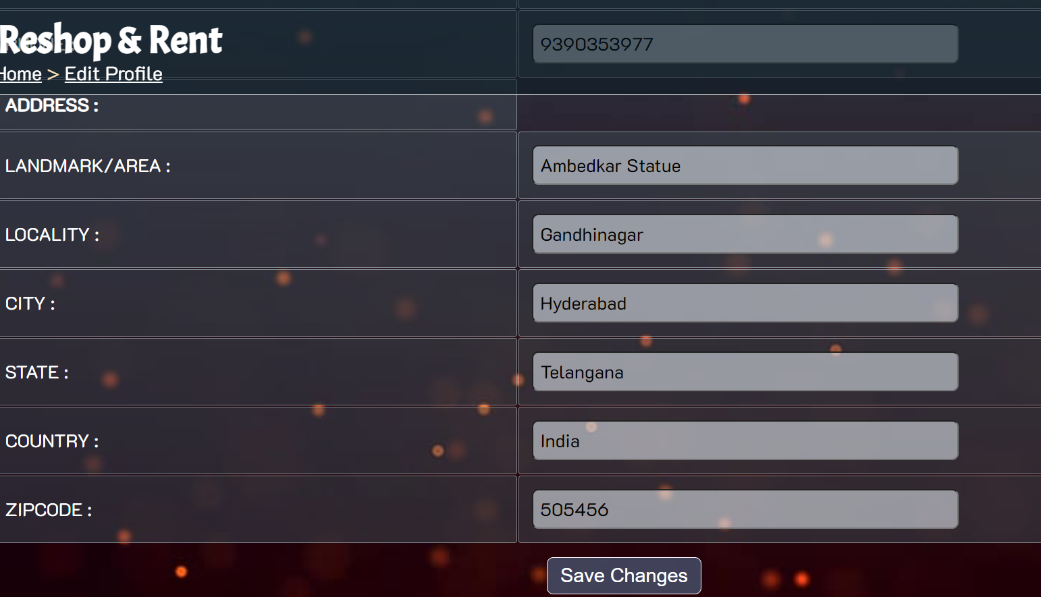
OUTPUTS

Slide 14
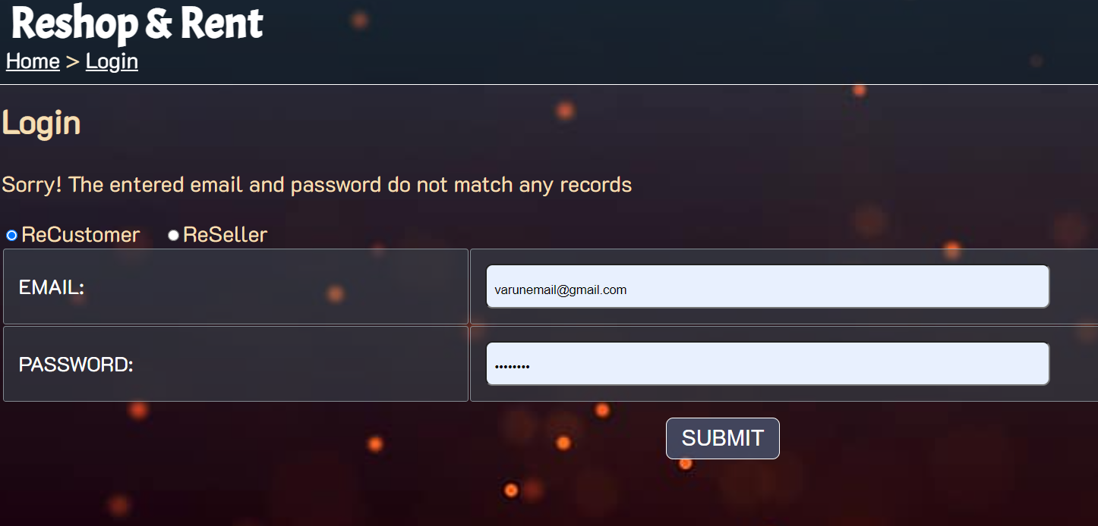
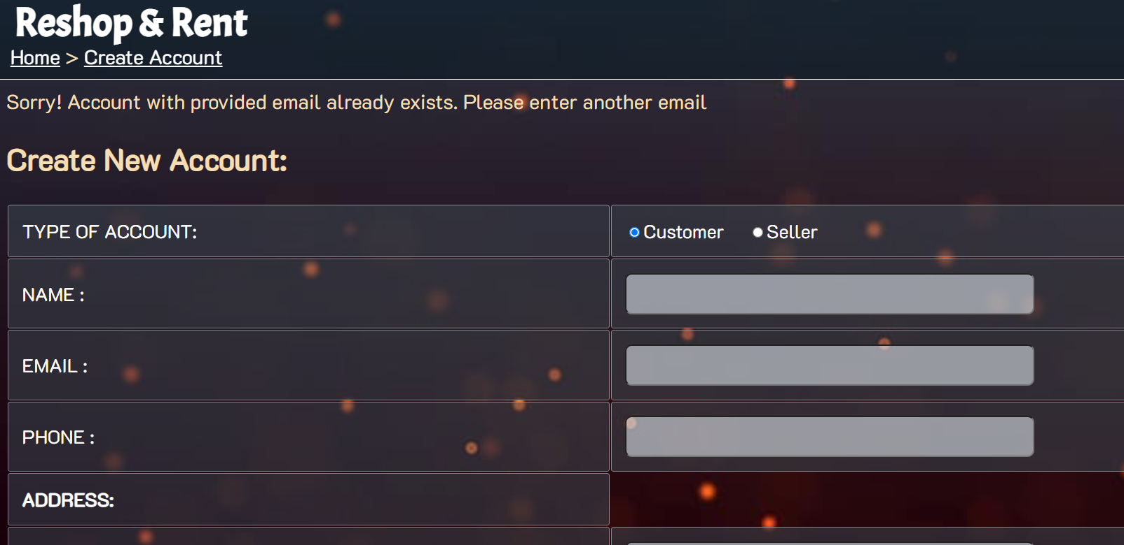
OUTPUTS

Slide 15
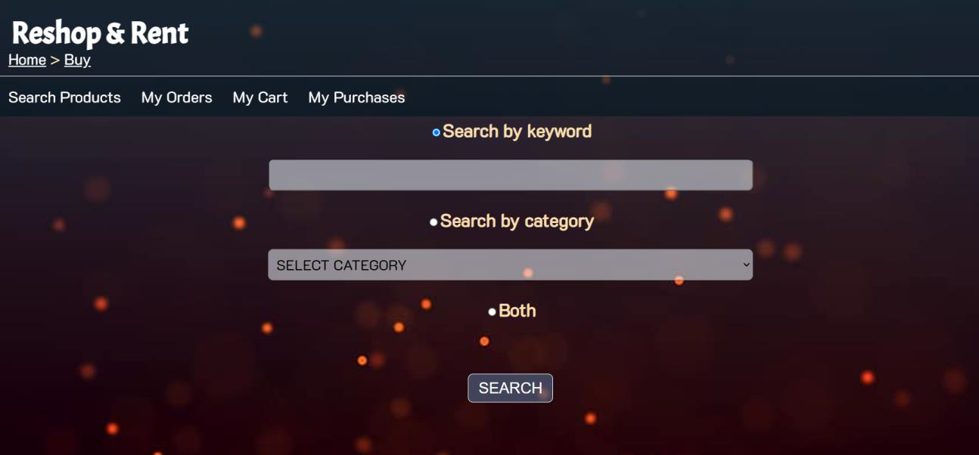
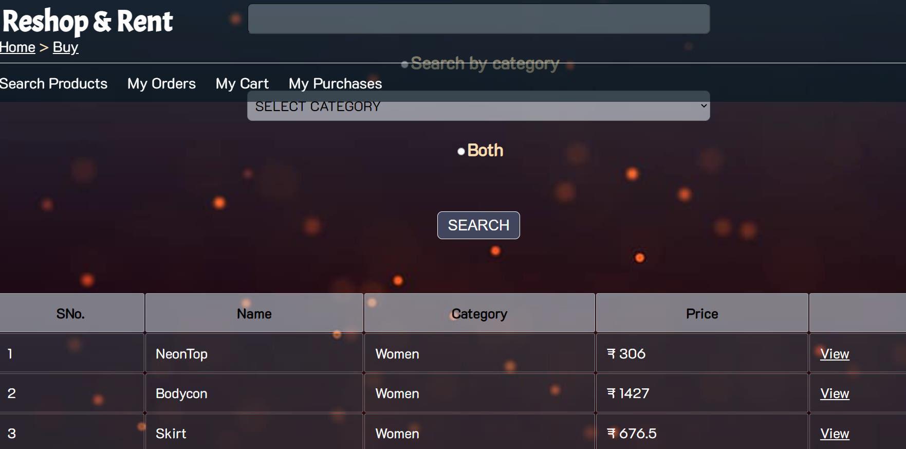
OUTPUTS

Slide 16
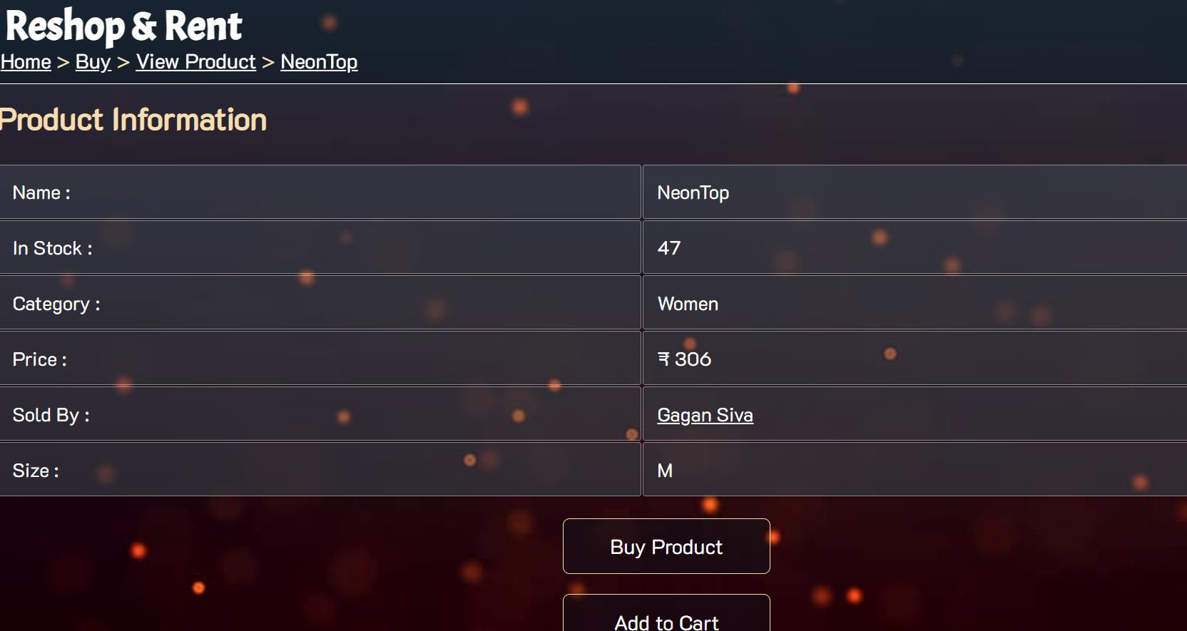
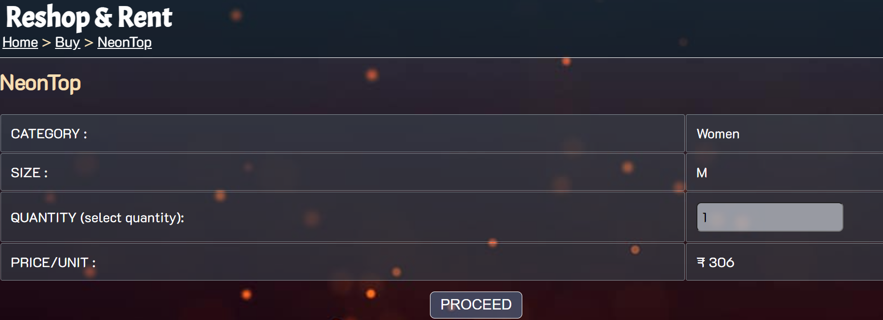
OUTPUTS

Slide 17
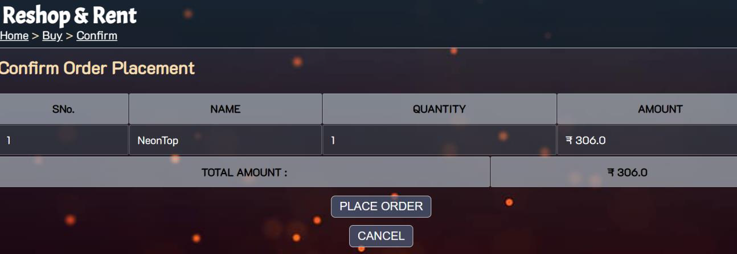
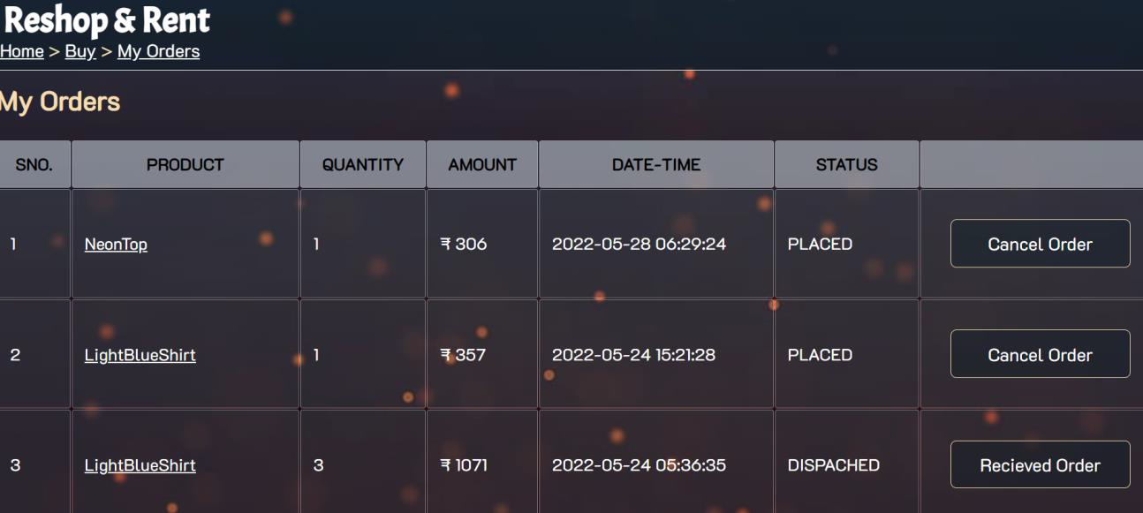
OUTPUTS

Slide 18
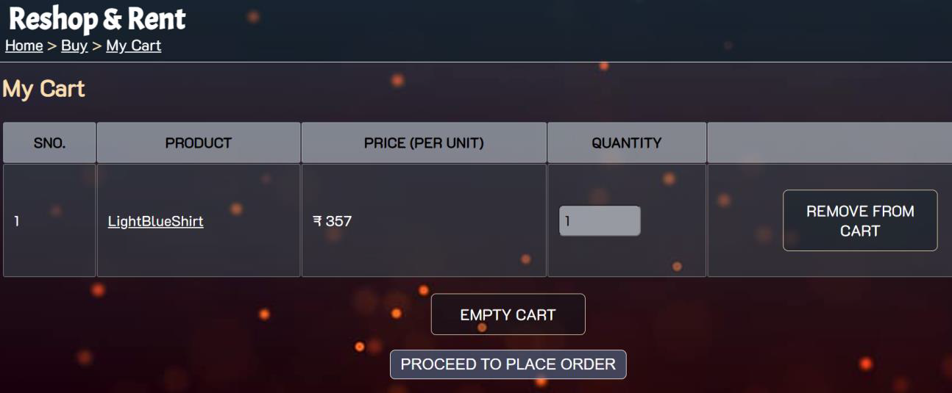
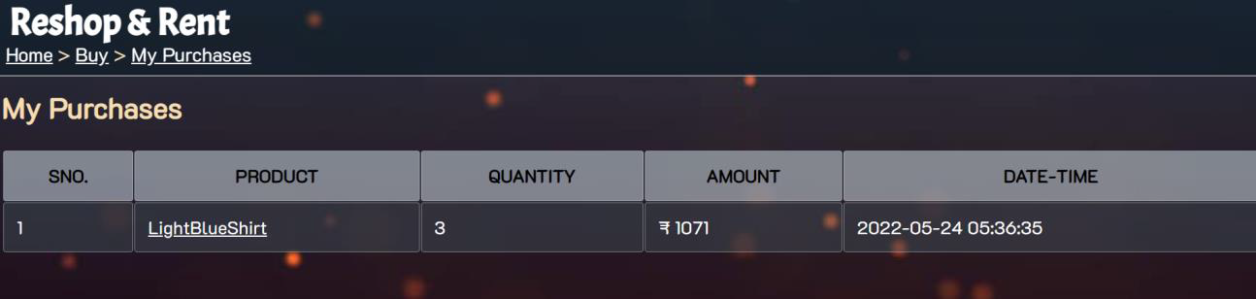
OUTPUTS

Slide 19
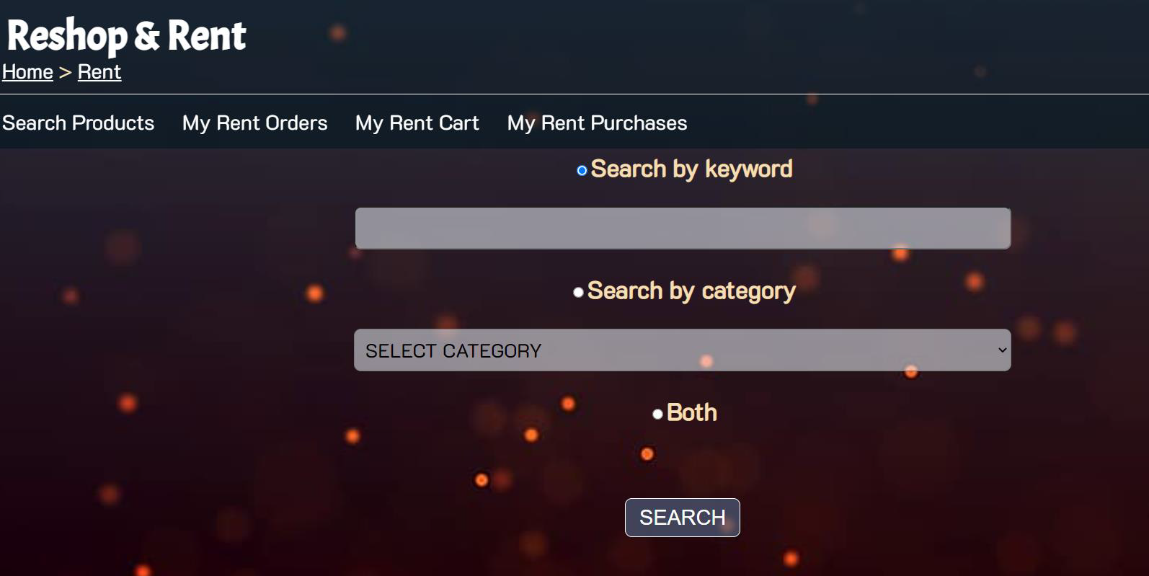
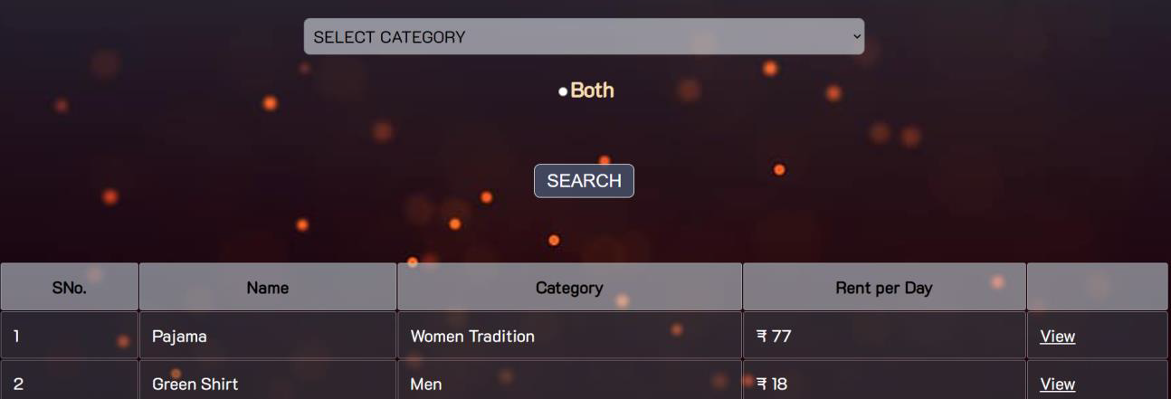
OUTPUTS

Slide 20
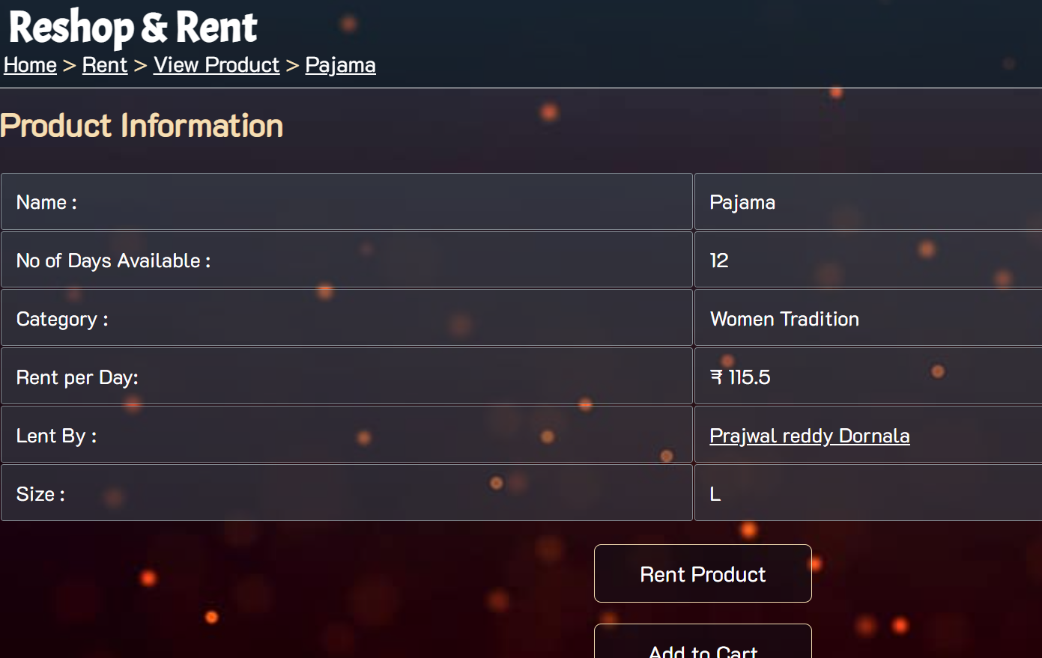
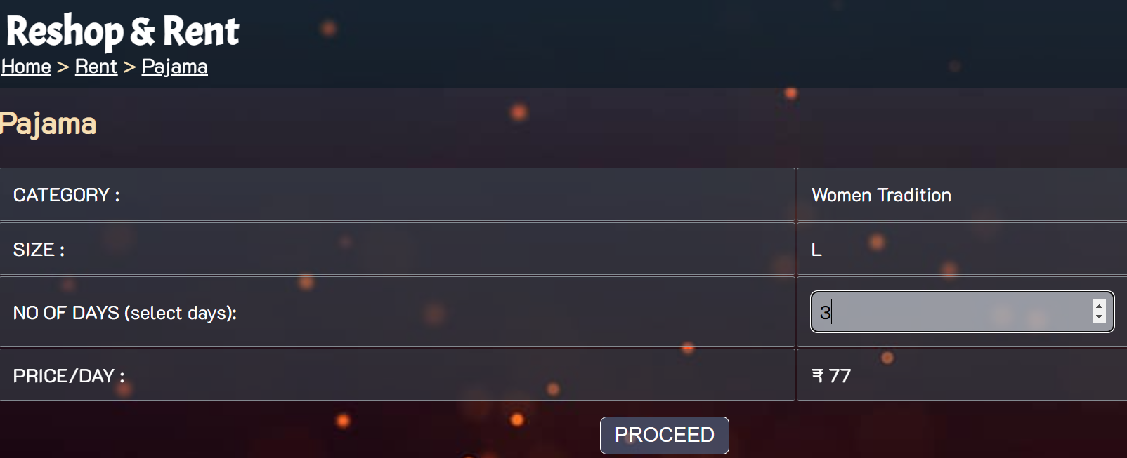
OUTPUTS

Slide 21
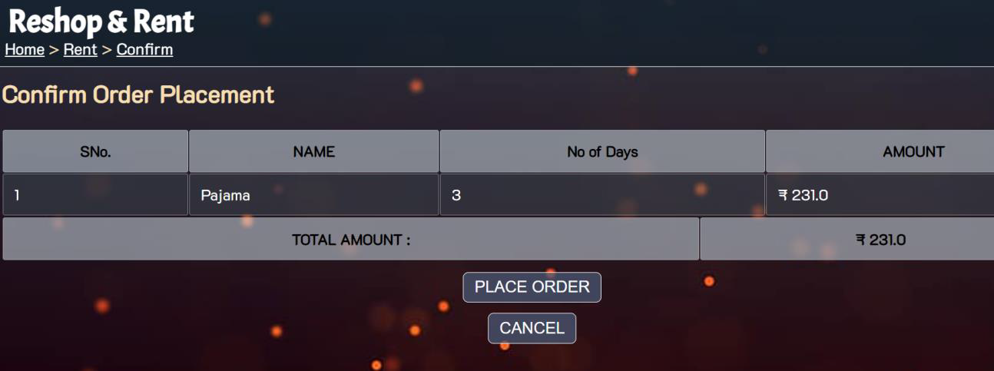
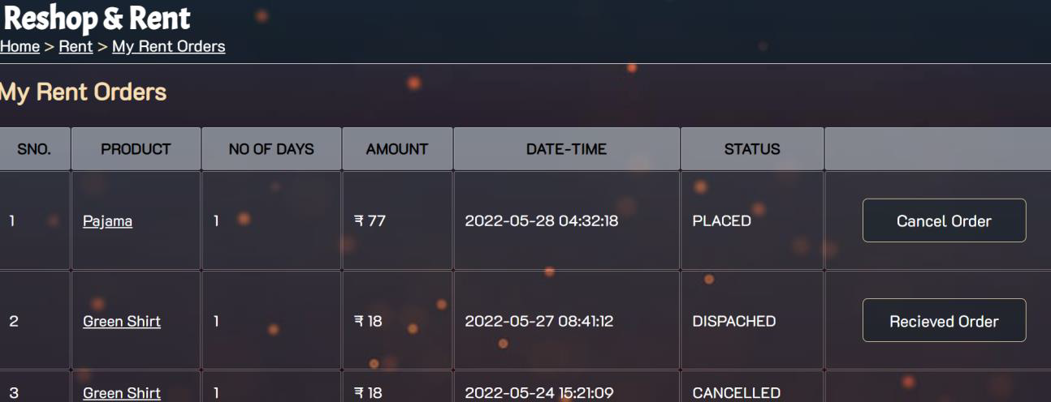
OUTPUTS

Slide 22
OUTPUTS

Slide 23
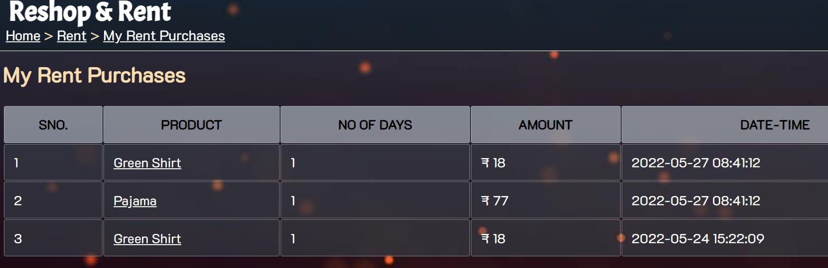
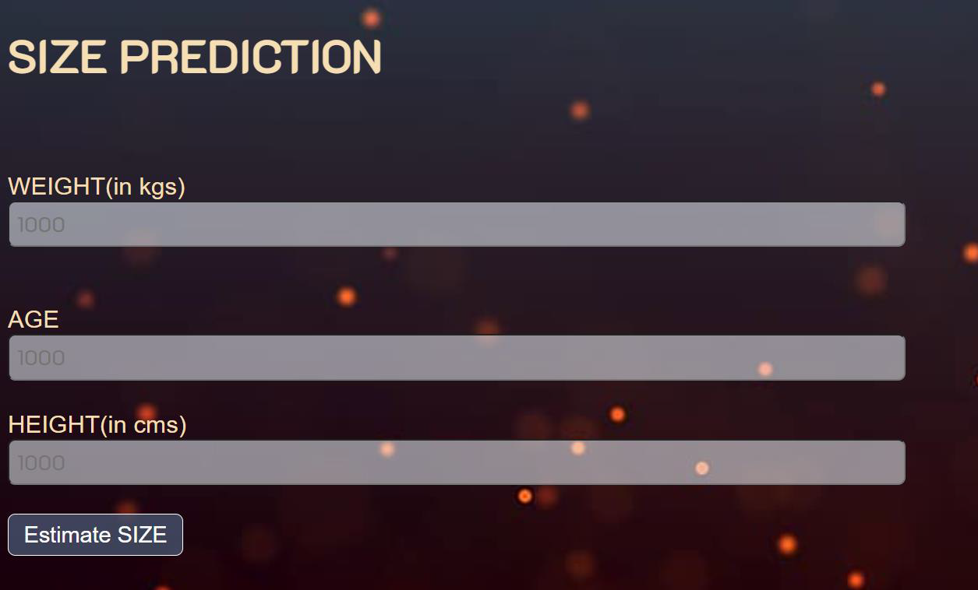
OUTPUTS

Slide 24
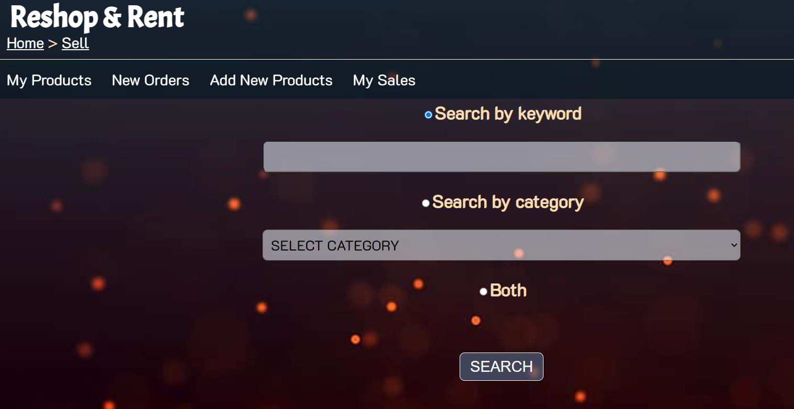
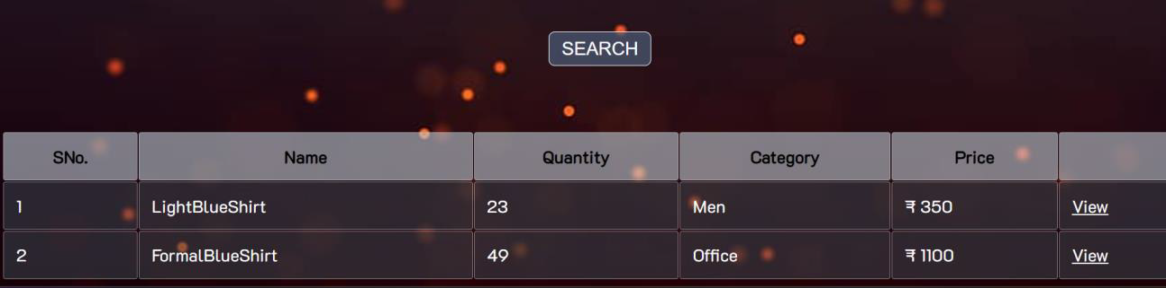
OUTPUTS

Slide 25
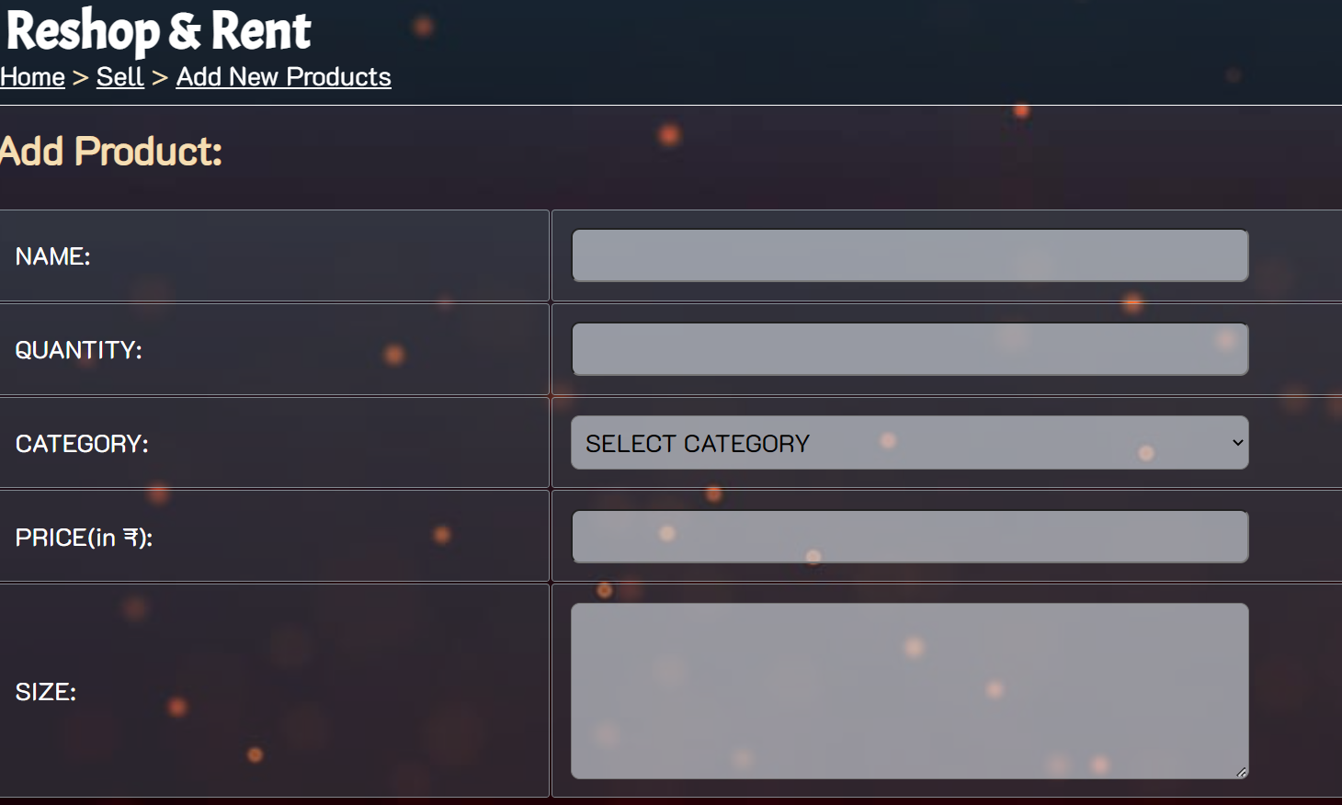
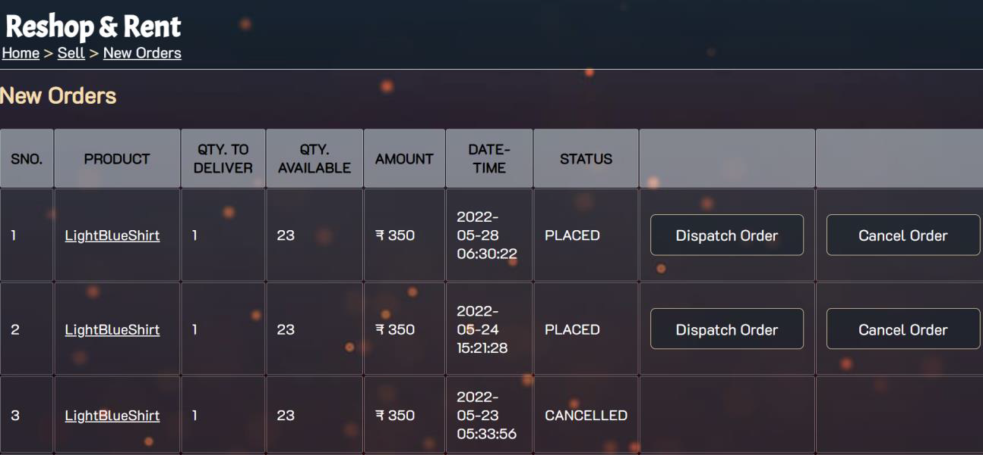
OUTPUTS

Slide 26
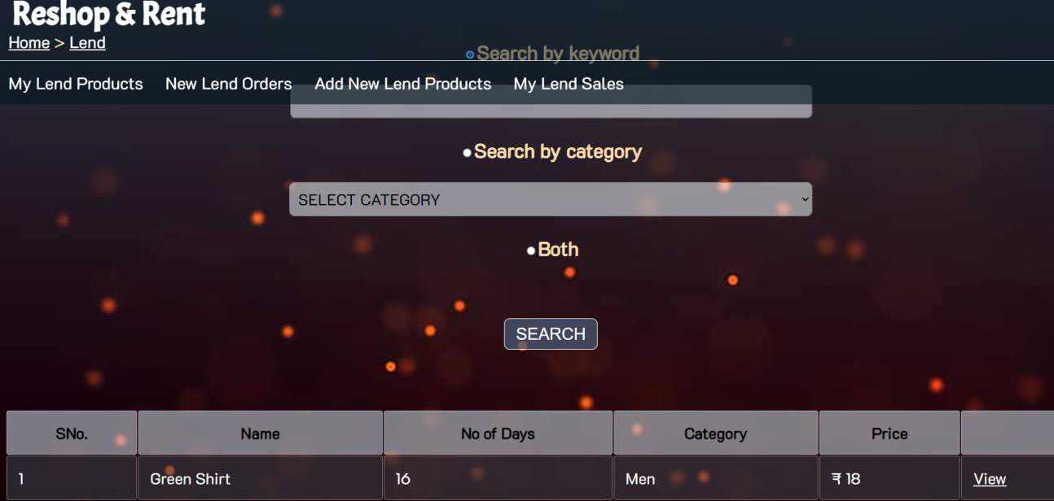
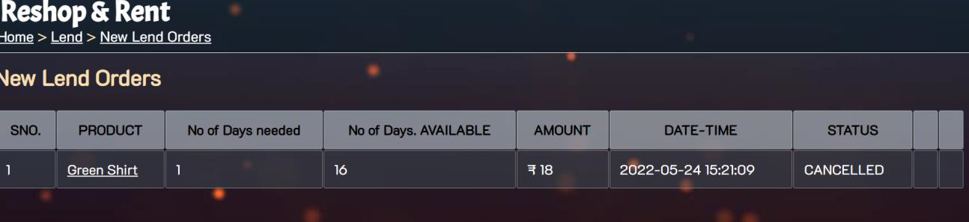
OUTPUTS

Slide 27
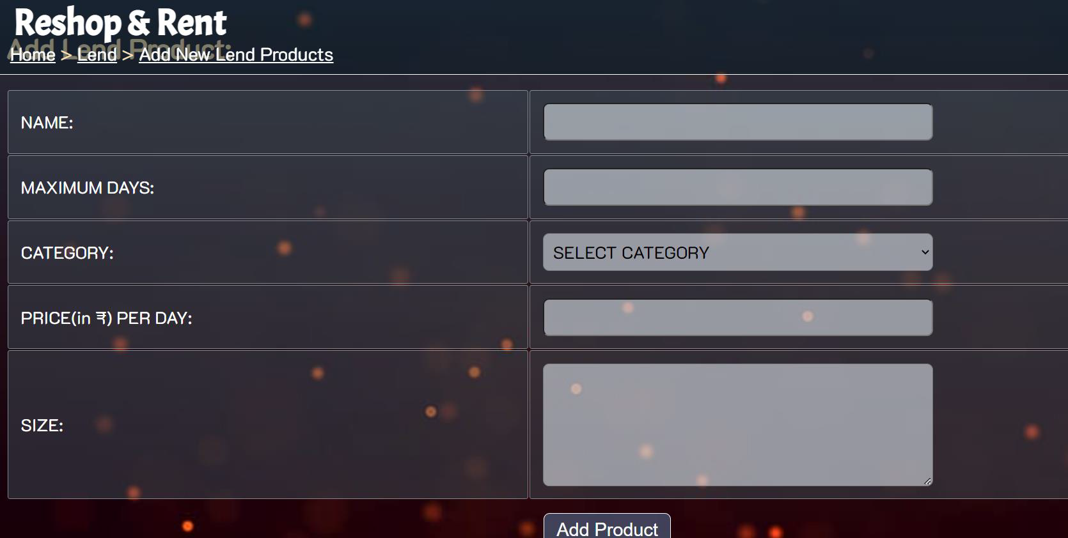
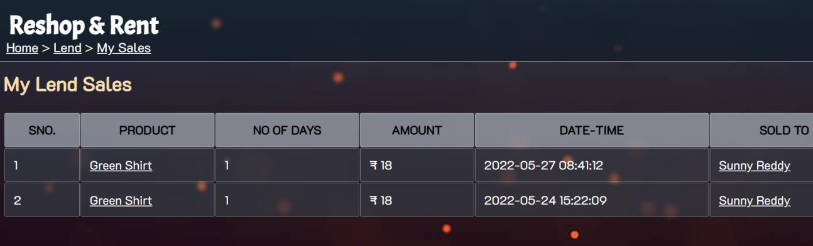
OUTPUTS

Slide 28
Limitations OF SIZE PREDICTION
Different Sellers use different measurements for various sizes.
Can not be completely dependable as body types differ

Slide 29
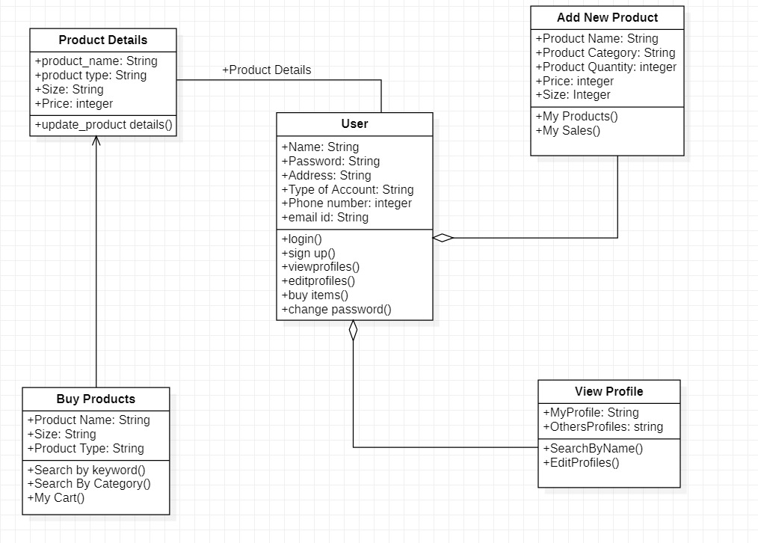
Class diagraM

Slide 30
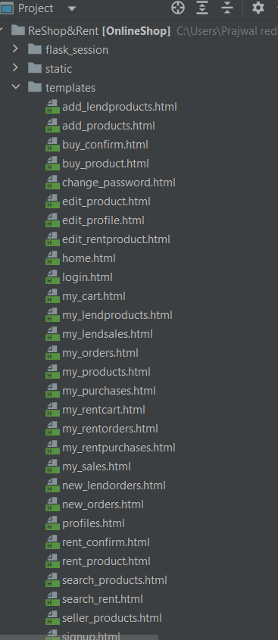
Problem Statement
DIRECTORY STRUCTURE

Slide 31
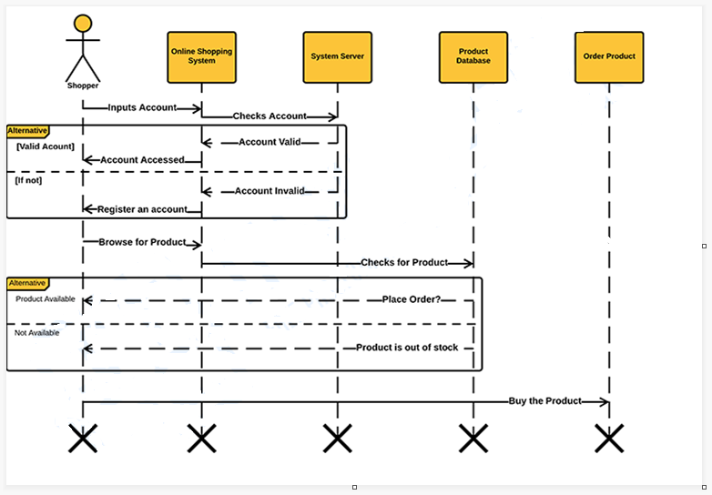
Problem Statement
SEQUENCE DIAGRAM

Slide 32
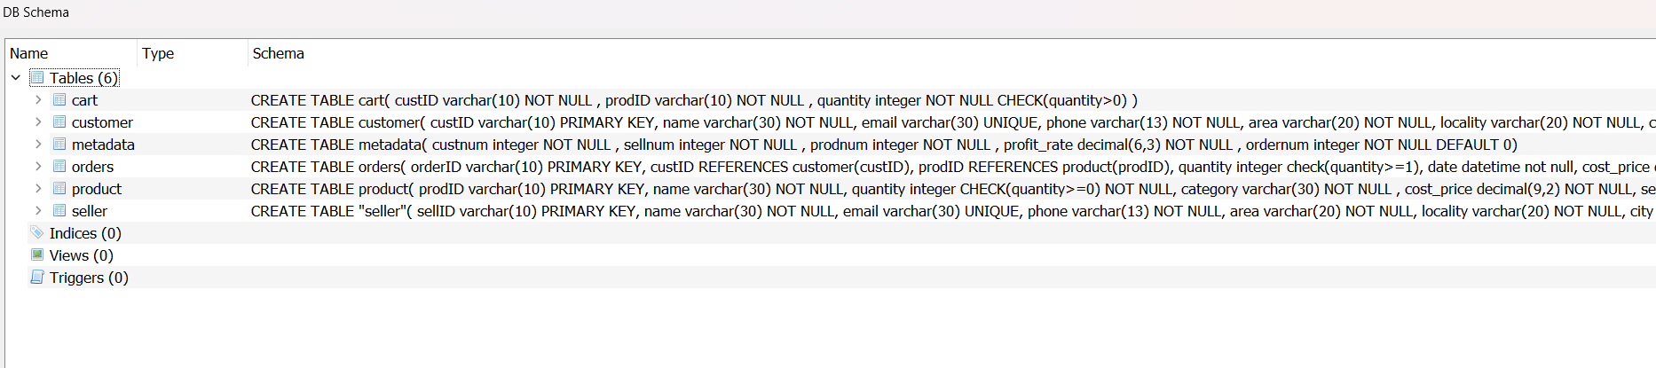
Database schema

Slide 33
REFERENCES
REFERENCES
1. HTML DOCUMENTATION - https://www.php.net/docs.php
2. FLASK DOCUMENTATION- https://flask.palletsprojects.com/en/2.1.x/
2. Problem Statements on SIH - https://www.sih.gov.in/sih2020PS
3. Sample Ecommerce Application http://www.NewEgg.com
6 Ajax Toolkit controls http://asp.net/ajax
4. i-SHOP: A Model for Smart Shopping, Journal by Authors- Anal Kumar; A.B.M. Shawk : https://ieeexplore-ieee-org-vce.knimbus.com/document/7941952
5. Online re-purchase intention: Testing expectation confirmation model ECM on online shopping context in Iran :https://ieeexplore-ieee-org-vce.knimbus.com/document/6836757
6. The Design and Implementation of the Online Shopping System -https://ieeexplore.ieee.org/document/5571623

Slide 34
Thank You for your attention

